Slide 1



2 Twelve Solutions
PROJECT
2 Twelve Solutions - ORE overview and Phases
DATE
CLIENT
PHASE
7 December 2022
2 Twelve Solutions, LLC All Rights Reserved 2018

Slide 2
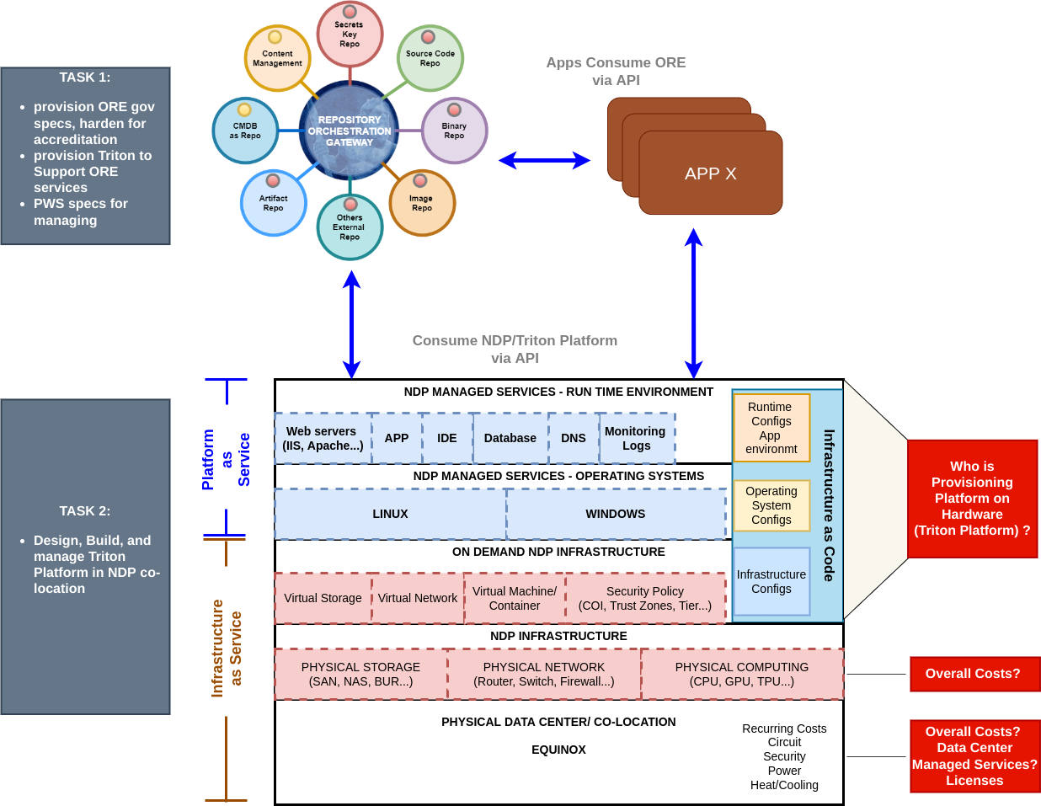
Triton Platform
Notes:
Jake
Need to stress why this is critical
Peer review of data allows supervision
Knowledge is distributed
Help prevent vendor lock in of knowledge

Slide 3
ORE and Triton Platform
Notes:
Jake
Need to stress why this is critical
Peer review of data allows supervision
Knowledge is distributed
Help prevent vendor lock in of knowledge

Slide 4
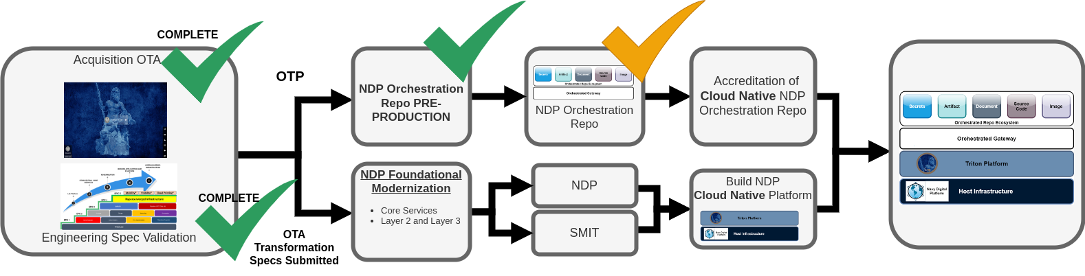
ORE and Triton Platform Timeline
Notes:
Jake
Need to stress why this is critical
Peer review of data allows supervision
Knowledge is distributed
Help prevent vendor lock in of knowledge

Slide 5
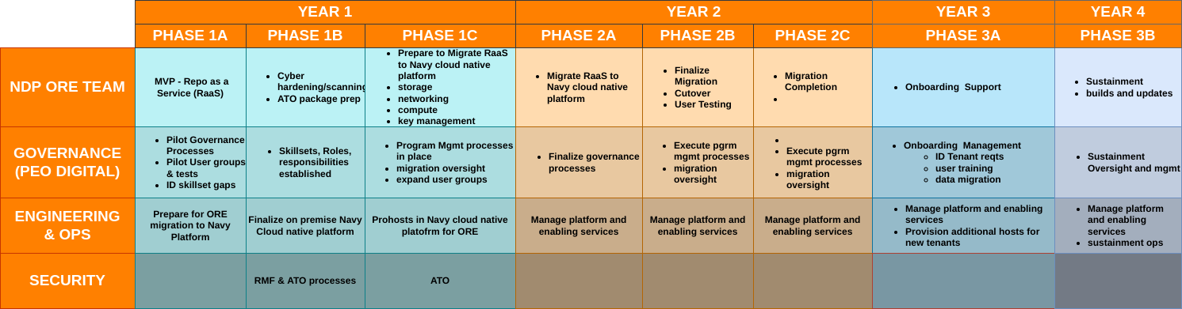
ORE and Triton Platform Timeline
Notes:
Jake
Need to stress why this is critical
Peer review of data allows supervision
Knowledge is distributed
Help prevent vendor lock in of knowledge

Slide 6
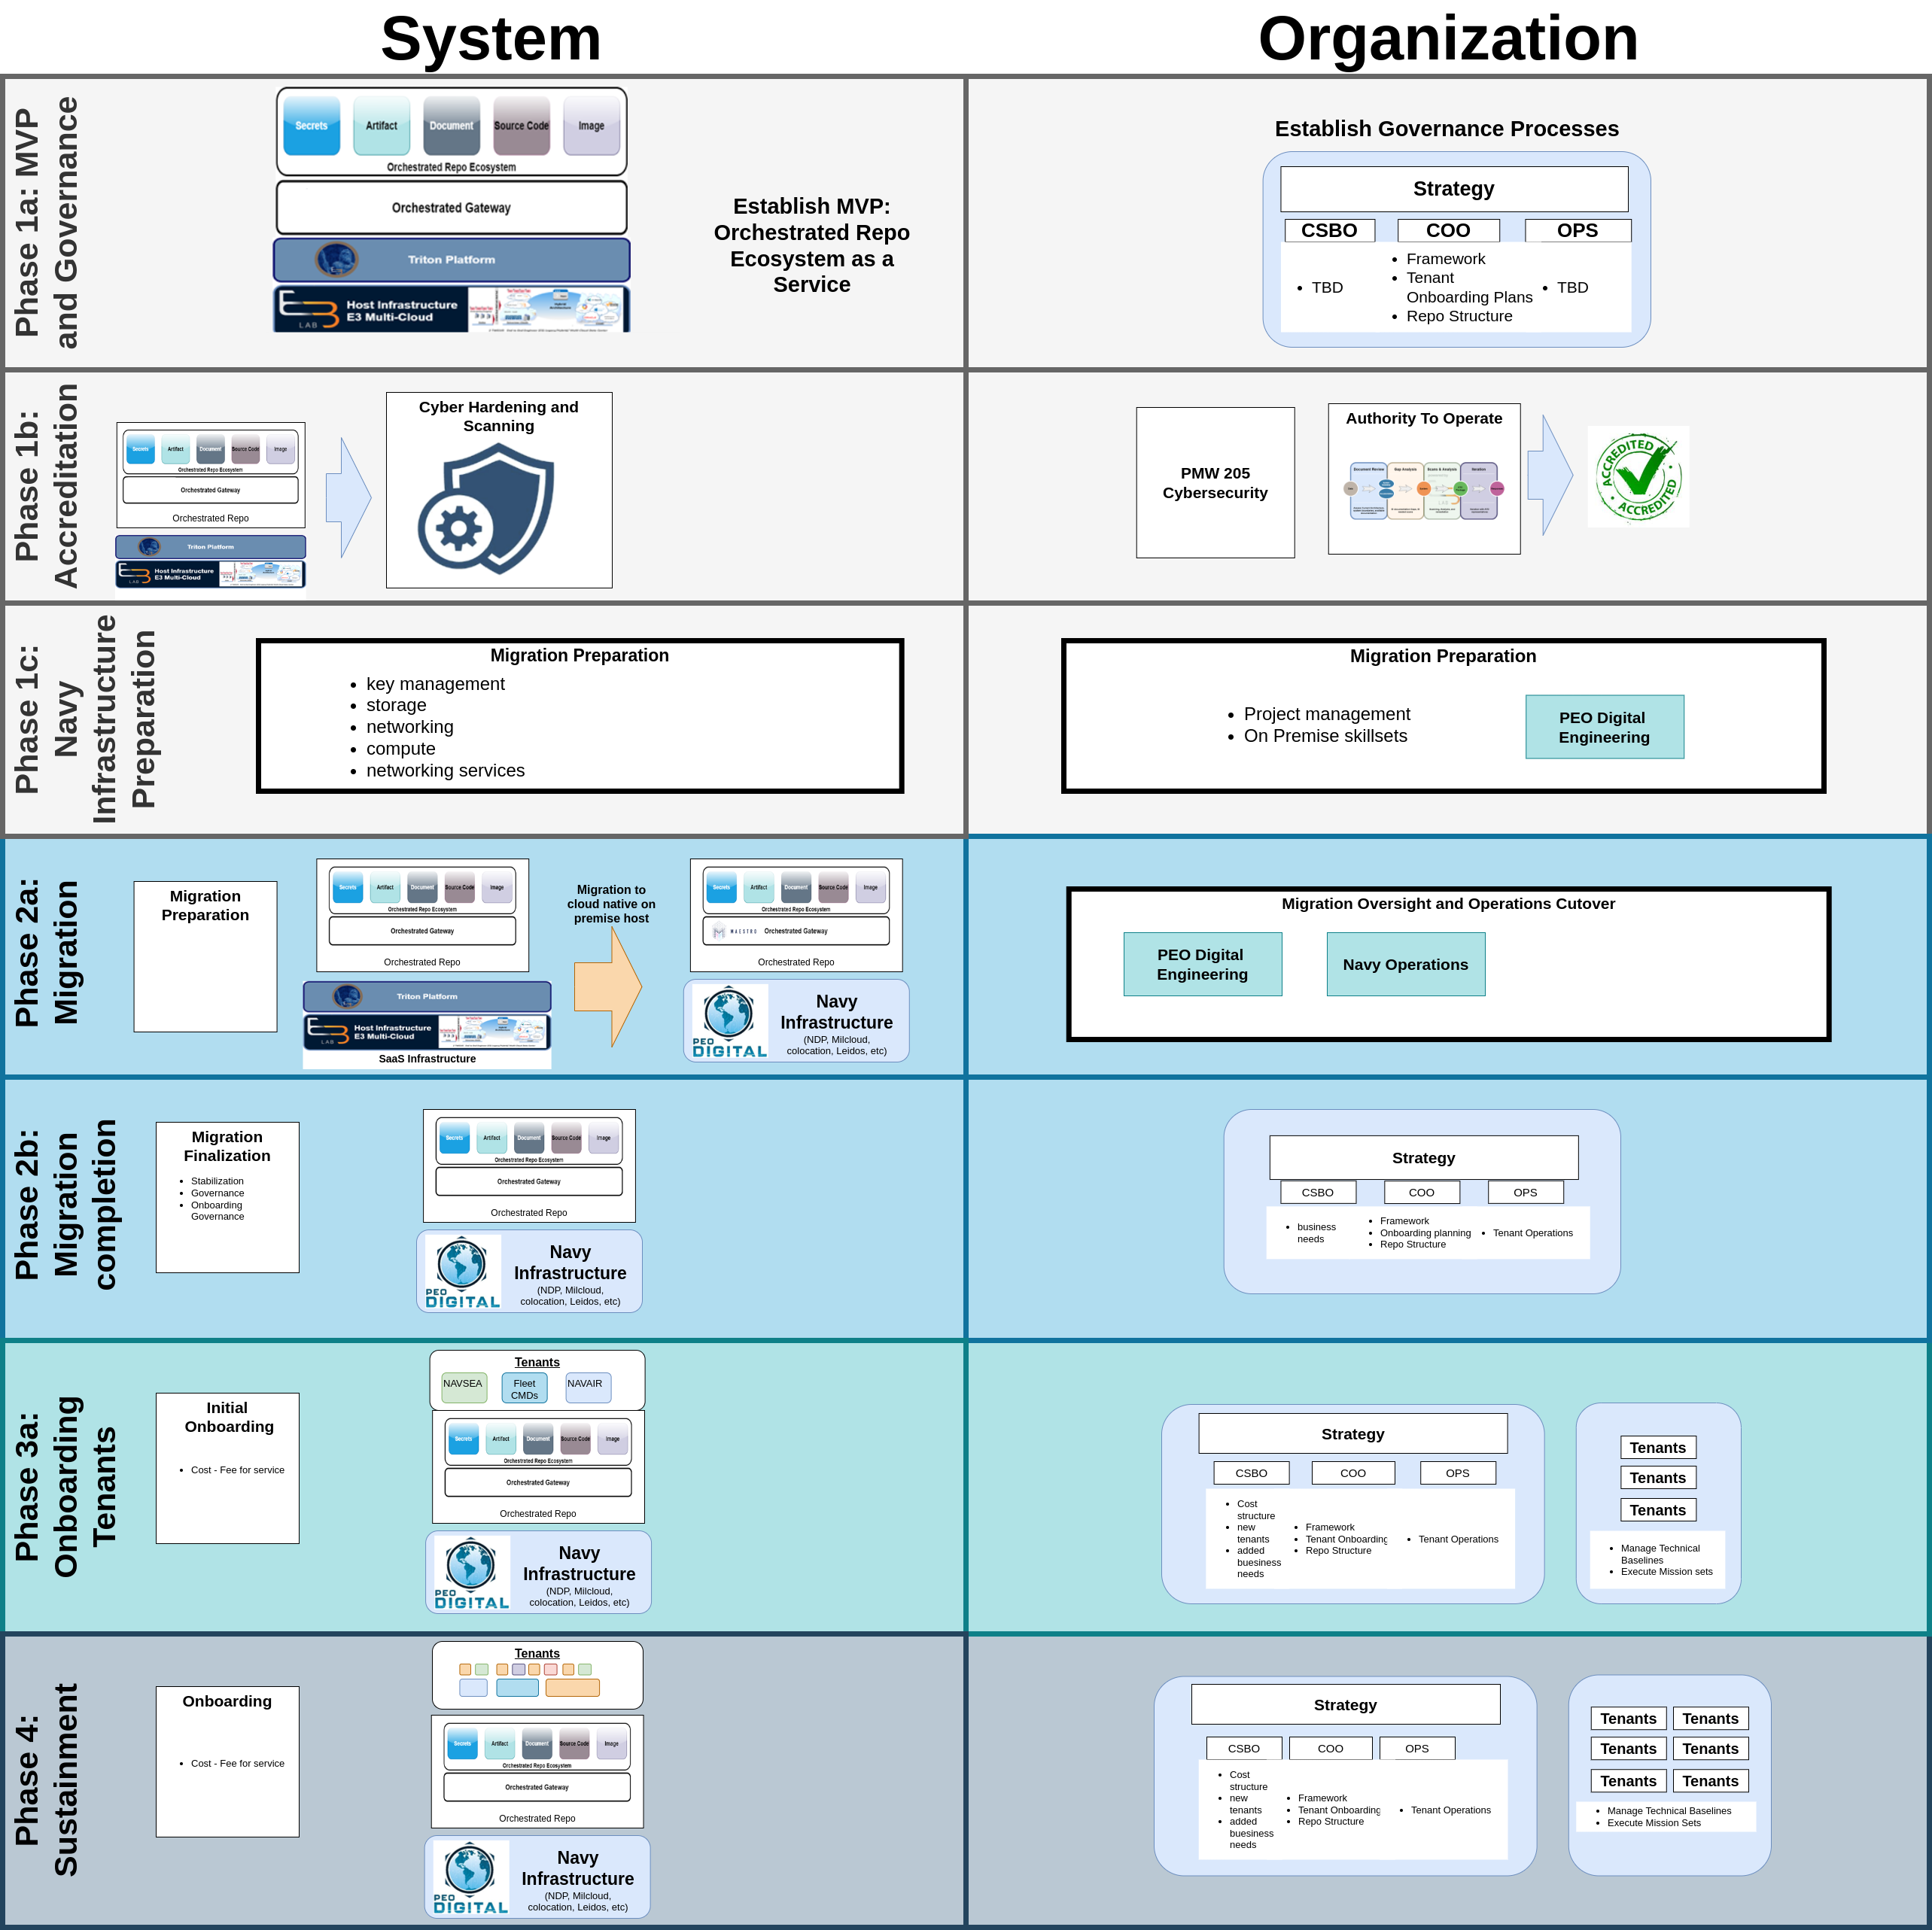

Slide 7
ORE and Triton Platform Phase 1
Notes:
Jake
Need to stress why this is critical
Peer review of data allows supervision
Knowledge is distributed
Help prevent vendor lock in of knowledge

Slide 8
ORE and Triton Platform Phase 2
Notes:
Jake
Need to stress why this is critical
Peer review of data allows supervision
Knowledge is distributed
Help prevent vendor lock in of knowledge

Slide 9
ORE and Triton Platform Phase 3 & 4
Notes:
Jake
Need to stress why this is critical
Peer review of data allows supervision
Knowledge is distributed
Help prevent vendor lock in of knowledge

