Slide 1
ORE -SCOPE OF TASK ORDER #1

Slide 2
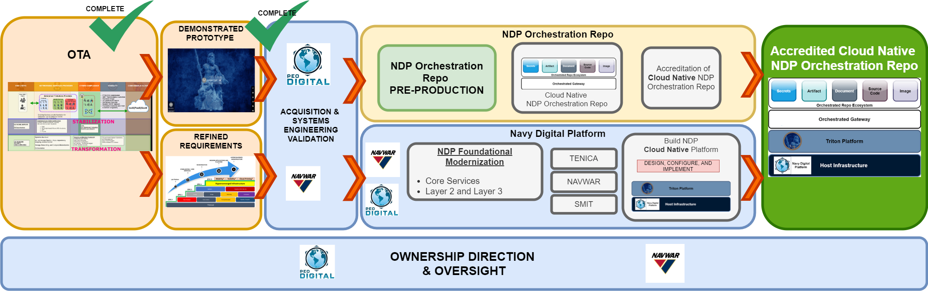
OTA to Cloud Native Orchestration Repo
Current Status

Slide 3
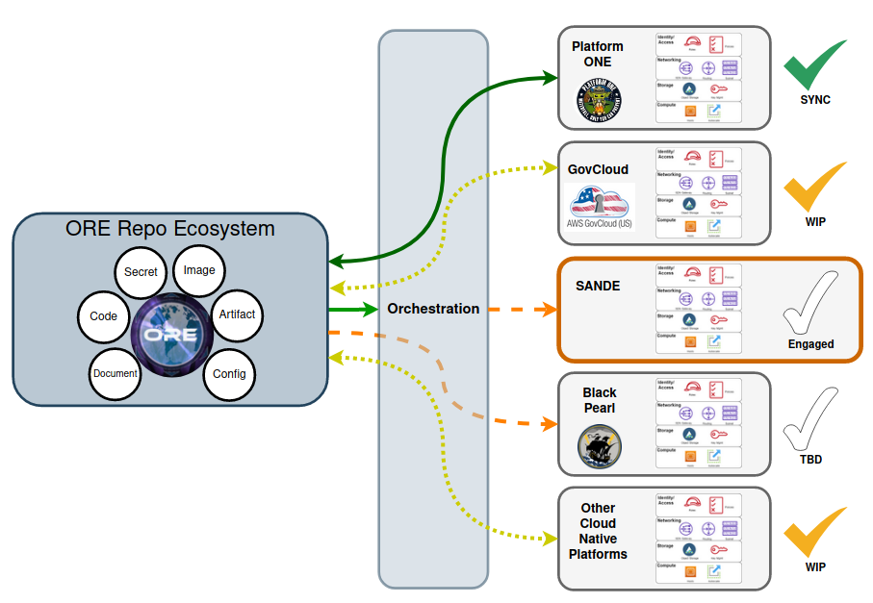
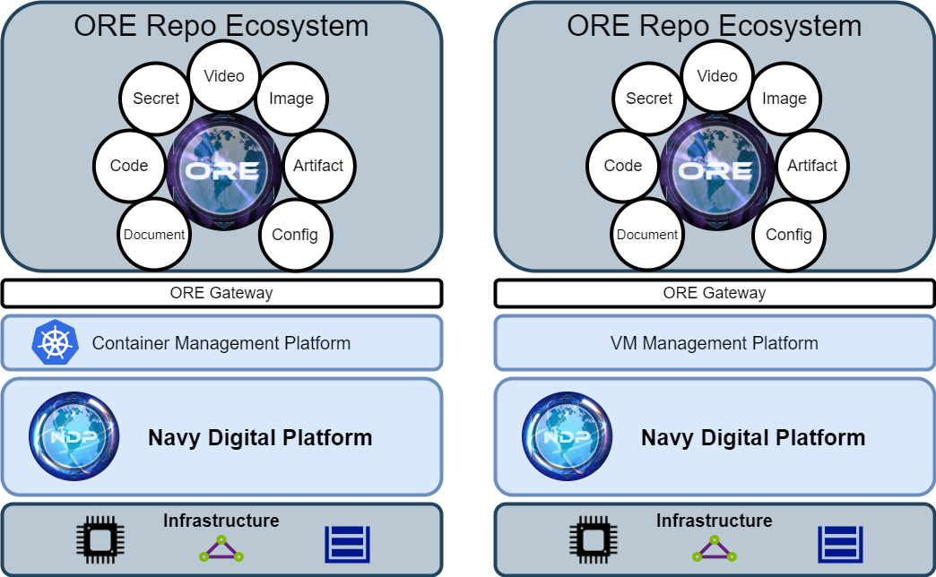
Task Order 1-ORE Integration Status
PWS- Task order 1
Provisioned ORE on Cloud native API platform-
Provision Cloud Native Platform to host the ORE - complete \
Configure to gov provided specs in PWS - In progress-(ie. Hardening, piv integration etc)
ORE IS Ready to be consumed by end users and developers for engineering activities.
On going Integration activities
  Platform 1 (AWS)
  Flank Speed ( TBD)
  RAM (In works)
  SANDE ( In works provided requirement for API end point integration)
  Core Node- ( Need cloud native API platform to host in Core node). Details provided in epic 1-5 of the OTA to Government)
ORE is an API provider and Consumer
Initial Task Order 1: Integration of Government Directed API End points to the ORE to democratize various development activities

Slide 4
ORE IS READY-
How to Connect (consumer- user)

Slide 5
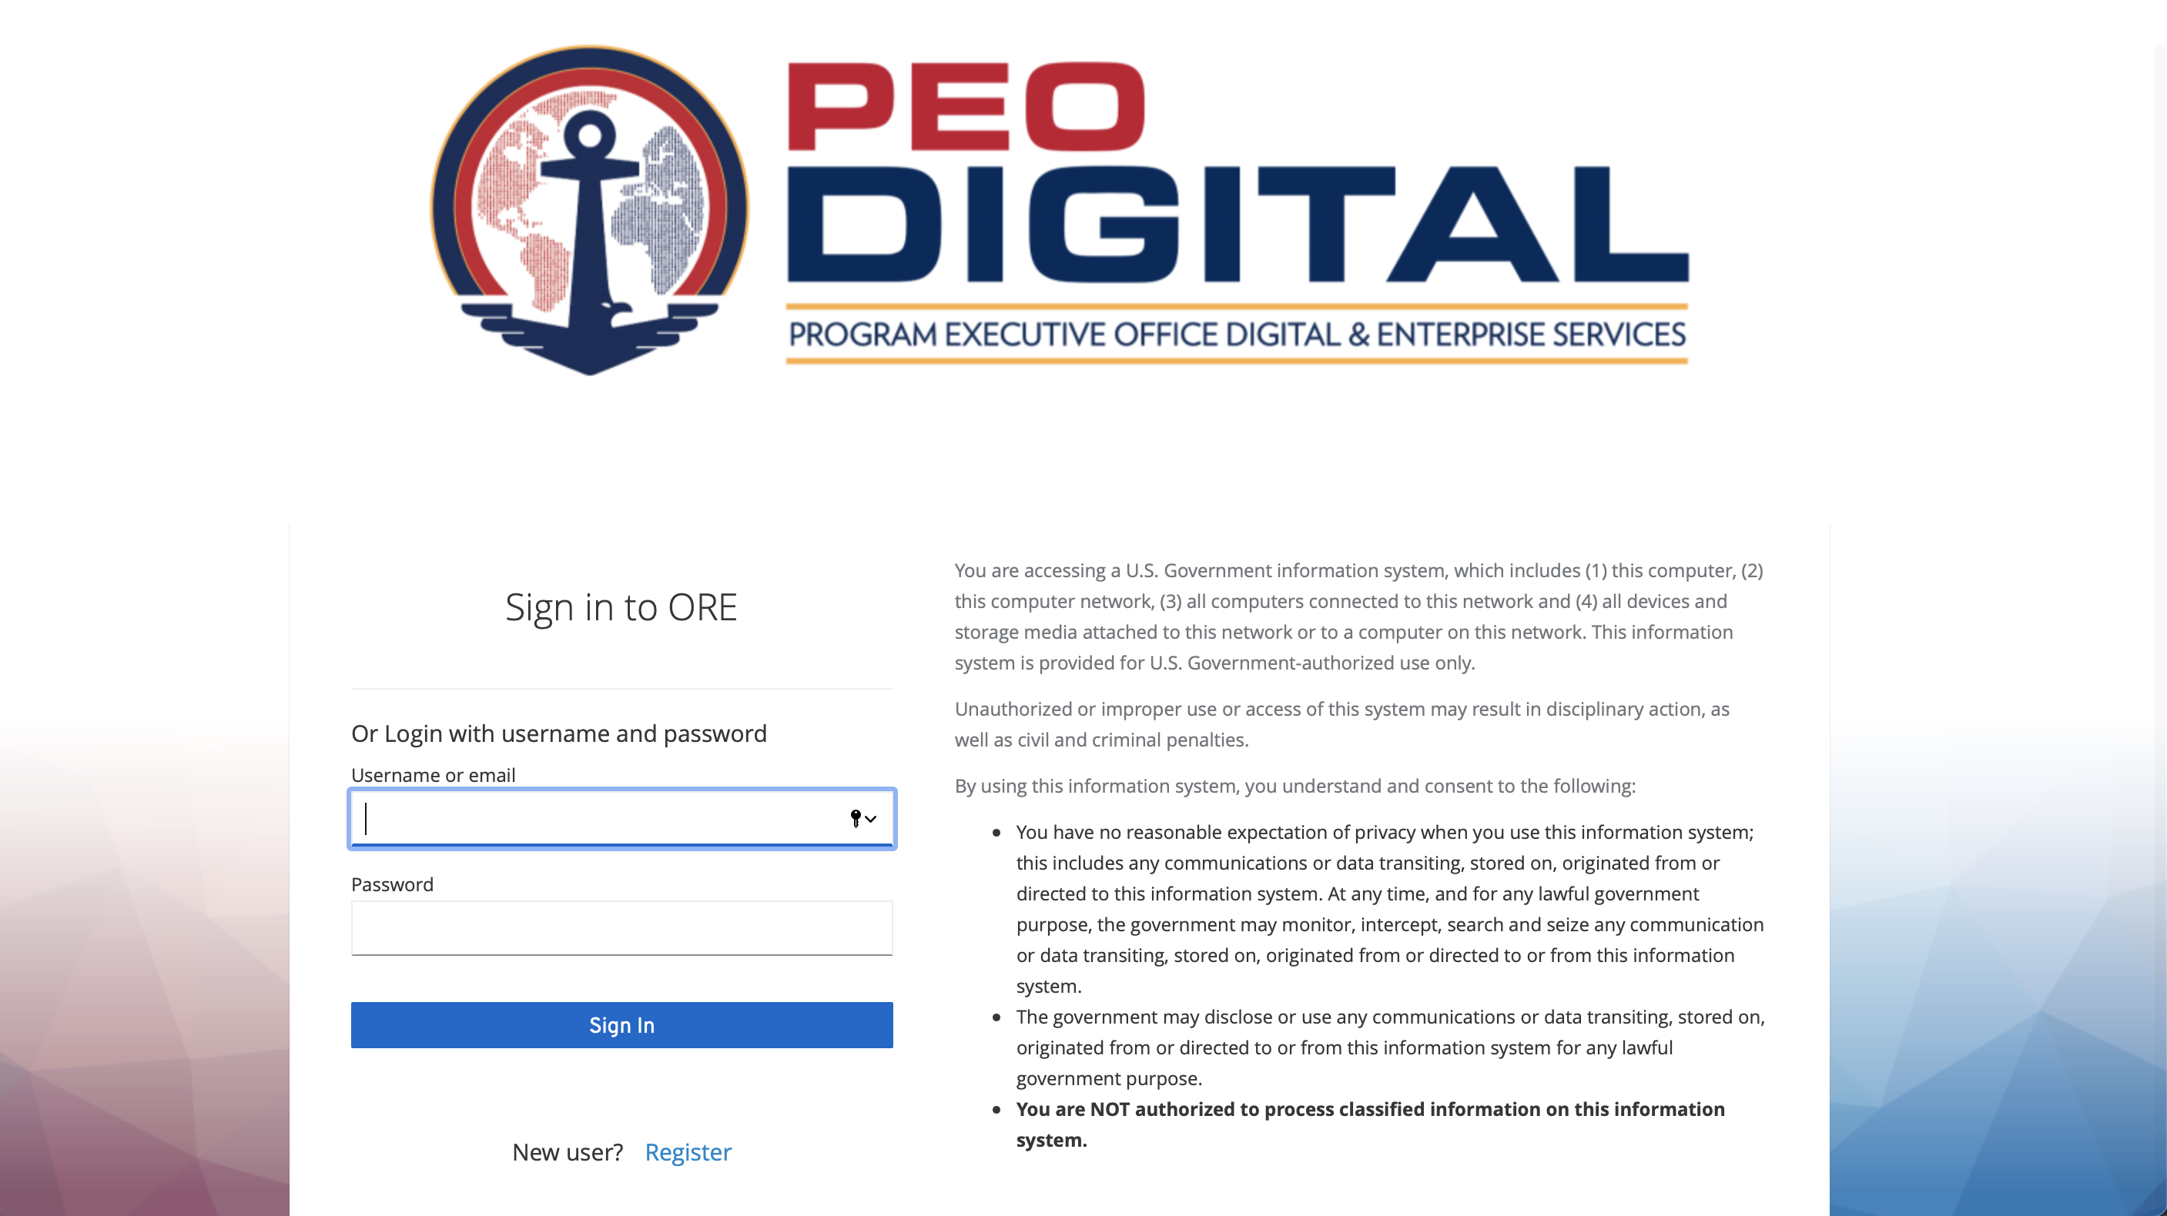
Consumer access

Slide 6
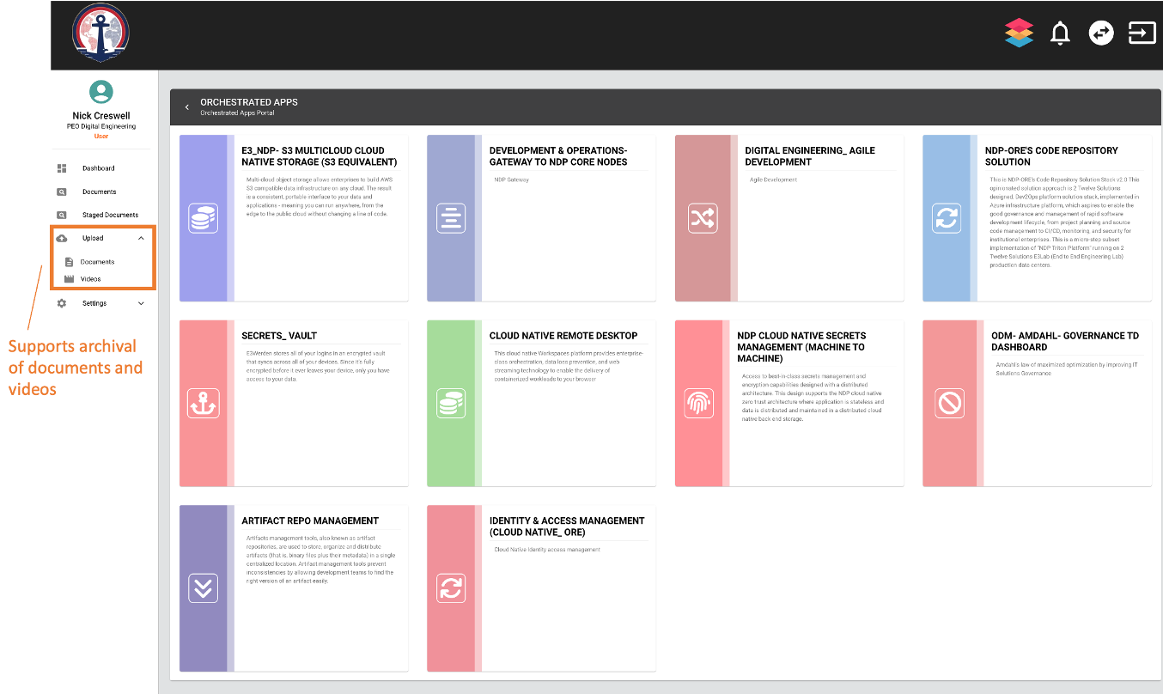
Engineering Provider Services
Orchestrated Apps Page
Implemented Repo Ecosystem

Slide 7
How to Connect :
(Provider -API integration)

Slide 8
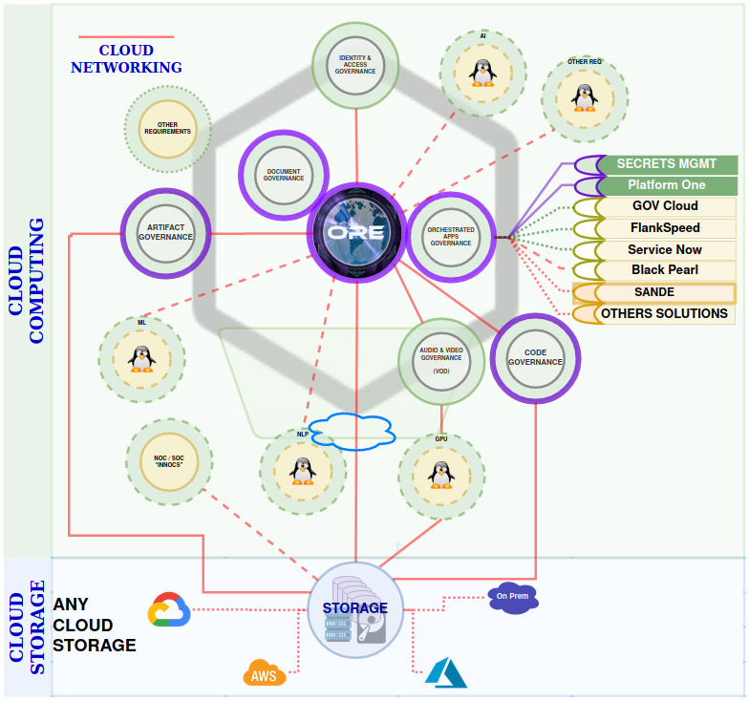
Orchestrating Multiple end points
ORE: Requirement to sync ORE with SANDE repo
To connect the ORE to “SANDE”, the solutions provider must simply provide the following...
1. Cloud native API consumable Zero Trust endpoint, i.e., secure TLS accessible web node to “SANDE” source code repository(ies)
Note: NDP ORE preference is to integrate over TLS 1.3 endpoints, but if that is not possible, we do support several alternative legacy secure application data transport options.
2. Solution service providers’ preferred solution approach to credentials management for synchronization (i.e. keys, username-password, certs, tokens, etc)
Aspirational Standards
“Bezos API Mandate” or “Amazon API Mandate” circa 2002.
All teams will henceforth expose their data and functionality through service interfaces.
Teams must communicate with each other through these interfaces.
There will be no other form of interprocess communication allowed: no direct linking, no direct reads of another team’s data store, no shared-memory model, no back-doors whatsoever. The only communication allowed is via service interface calls over the network.
It doesn’t matter what technology is used. HTTP, Corba, Pubsub, custom protocols — doesn’t matter.
All service interfaces, without exception, must be designed from the ground up to be externalizable. That is to say, the team must plan and design to be able to expose the interface to developers in the outside world. No exceptions.
6) Anyone who doesn’t do this will be fired.
Requirement
Cloud native connections
  API driven
Service exposure
  Taking security functions typically layer 3 pushing to edge and letting applications handle
  Just need IP layer transport
Notes:
VDI is not a consummable API endpoint
, ZERO TRUST enabled CLOUD NETWORKING is strongly preferred.
ORE is an Cloud Native Application on Zero Trust Cloud Networking stack services, so API services are able to consume and be consumed, hence any solution which are also ZERO TRUST CLOUD NETWORKING enabled are able to consume and be consumed
Therefore,

Slide 9
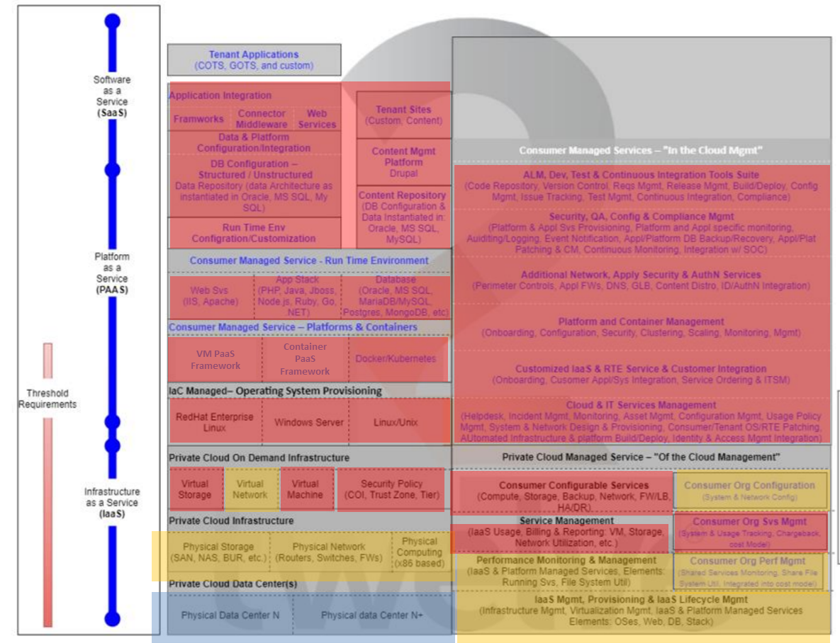
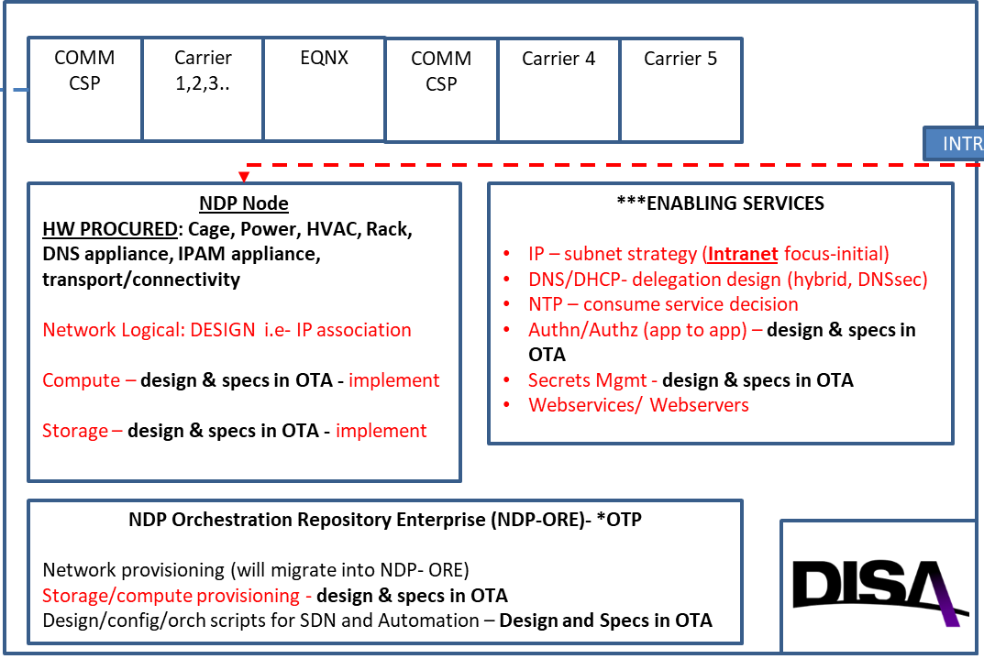
HOSTING REQUIREMENT IN THE CORE NODE
NDP Core Node Platform Mapping
NDP Core NODE platform dependencies
Specs in Red provided as OTA outcomes from Epic 1-5 to Government to drive implementation and provisioning in the core node

Slide 10
WBS TASK 1

Slide 11
WBS TASK 1

Slide 12
WBS TASK 1

